Slide 1
Tutorial 3: Mastering Organic Matter Analysis through Fourier-transform Ion Cyclotron Resonance (FTICR) Mass Spectrometry Data Processing.
Will Kew
Chemist
william.kew@pnnl.gov
November 7th, 2023

Slide 2
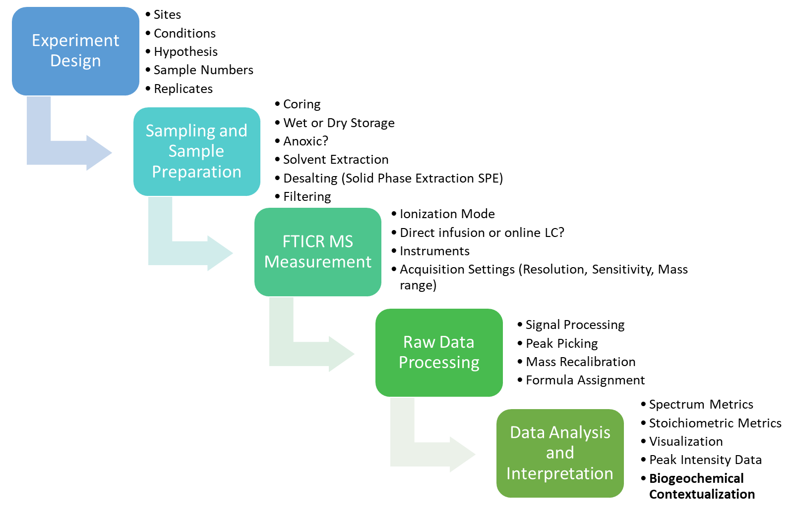
Brief Recap
This Session

Slide 3
Raw Data Processing
For reference only!
MONet will do this process
Time domain to Mass Domain
Peak Picking
Mass Recalibration
Formula Assignment

Slide 4
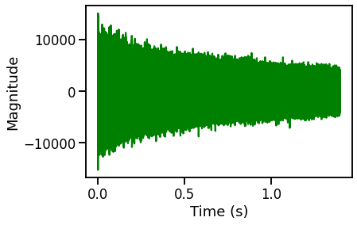
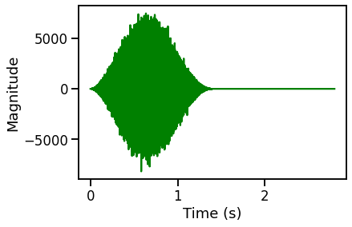
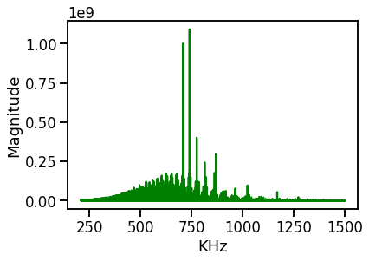
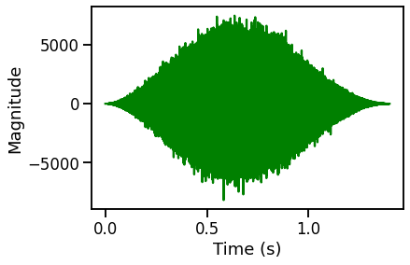
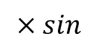
Raw Data in FTICR – Time Domain
This is almost always done ‘behind the scenes’
Time domain signal is recorded (‘transient)
Transient is ‘zero-filled’
FFT
$$×sin$$
zf
Transient is Fourier transformed to the ‘frequency domain’
Transient is ‘apodized’ (window function applied)

Slide 5
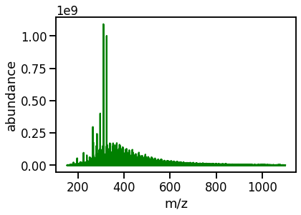
Raw Data in FTICR – Frequency to Mass Domain
This is almost always done ‘behind the scenes’
m/z domain spectrum
Frequency domain spectrum
Instrument specific calibration function
Note – Every instrument has its own specific calibration function coefficients
For FTICR instruments, the frequency (and thus m/z) depends on the magnetic field strength
Higher magnetic field = higher frequency = higher mass resolution

Slide 6
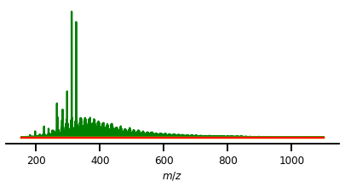
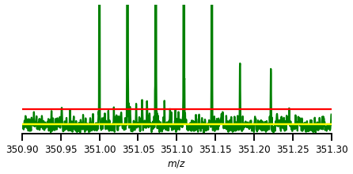
Noise Thresholding and Peak Picking in FTMS
This is almost always done ‘behind the scenes’
Next, we process the spectrum to extract the information about the peaks
Noise thresholding
Determination of the spectrum noise level
User defined level above which to accept signals as ‘real’
‘signal-to-noise’ ratio (SNR, S/N)
Peak picking (centroiding)
Determination of each peaks properties
m/z
Intensity (peak height)
Resolution (width of peak)
Signal-to-noise ratio
Real peak
Noise Threshold
Noise Level

Slide 7
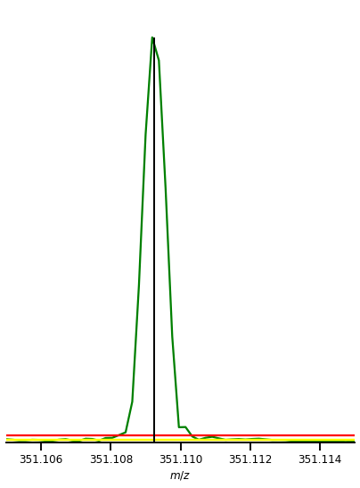
Noise Thresholding and Peak Picking in FTMS
This is almost always done ‘behind the scenes’
Intensity = y-axis maximum
High resolution data
Resolving Power is commonly used to describe the width of a peak
Resolution and Resolving Power are incorrectly used interchangeably
e.g. m/z / FWHM = R.P.
FWHM = 0.001
m/z = 351.00
Resolving Power = 351,000
m/z = center of the peak on x-axis
Resolution = full width at half max

Slide 8
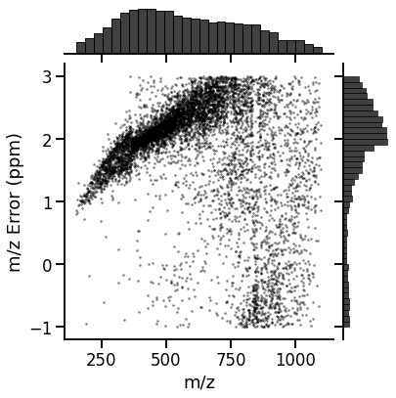
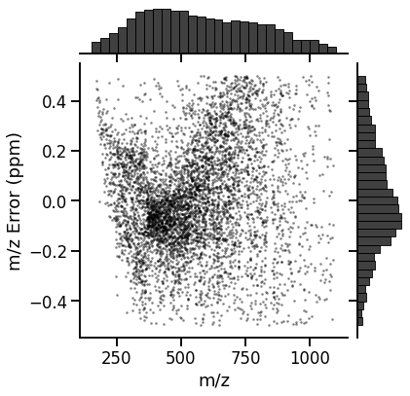
Mass Recalibration
Before recalibration:
Mean error is ~2ppm
Spread of errors is ~3ppm
The measured m/z values are often not exactly correct
Ion frequency shifts due to instrument drift, ‘space-charge’ effects, etc.
Almost always we will internally re-calibrate each spectrum
‘External Calibration’ = instrument default calibration
‘Internal Calibration’ = using known features within a spectrum to refine its calibration
Can use spiked in compounds, common contamination ions, or known endogenous molecules
For water extract SOM, we use expected CHO formula
Residual ‘error’ should be <1ppm
After recalibration:
Mean error is ~0ppm
Spread of errors is ~0.5ppm

Slide 9
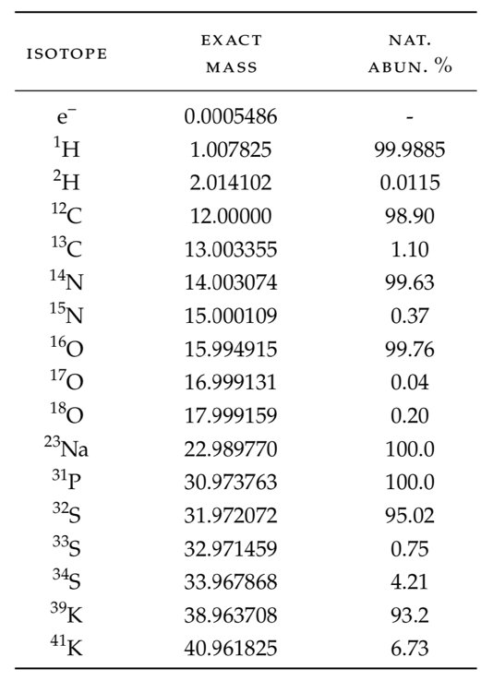
Formula Assignment
All isotopes have an exact mass
Known accurately to several decimal places
We have a ~1ppm uncertainty on our measured m/z values
We allow for certain ‘chemically plausible’ heuristics, for example:
Organic molecule: C > 1, H > 4
Negative ESI of NOM, O > 0
Not many N, S, P (N < 3, S<2, P < 1)
No other heteroatoms
[M-H]⁻ ion type
Calculate all possible combinations of atoms which give us the measured m/z value

Slide 10
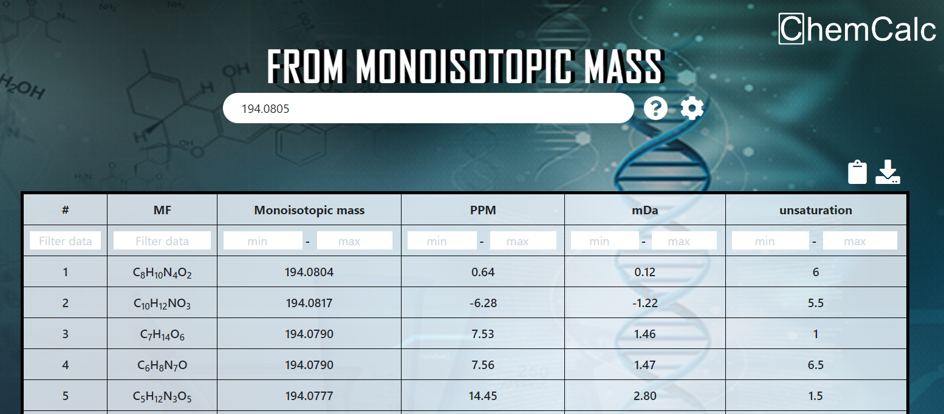
Formula Assignment
https://www.chemcalc.org/mf-finder
Obviously, we use software to do this – for example, a web app called ChemCalc
For this mass, only one formula is within 5 ppm – thus, we have our ‘unambiguous assignment’

Slide 11
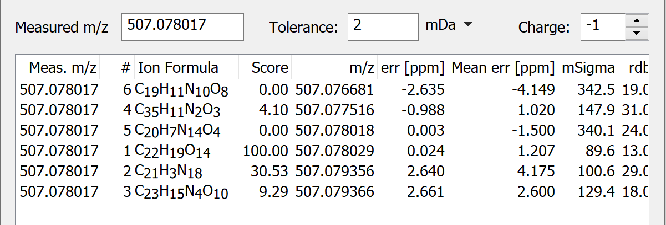
Formula Assignment
Or we can use commercial software, like Bruker DataAnalysis
At higher m/z values, the number of possible assignments within 1ppm becomes greater!
Here, the third option (C₂₂H₁₉O₁₄) is most likely correct
Chemistry – an N14 molecule is unlikely!
Sample + MS knowledge

Slide 12
Formula Assignment
Formula Assignment is not an exact science
In complex mixtures, there is always some uncertainty
Multiple possible formulas within the mass tolerances
Insufficient resolution
Too many elemental possibilities
Especially when we include CHNOSP and multiple ion types (e.g. [M-H]⁻ and [M+Cl]⁻)
Historic convention
Pick a single ‘best match’
Modern approach
“Embrace the ambiguity”
Sometimes, one peak is multiple formulas

Slide 13
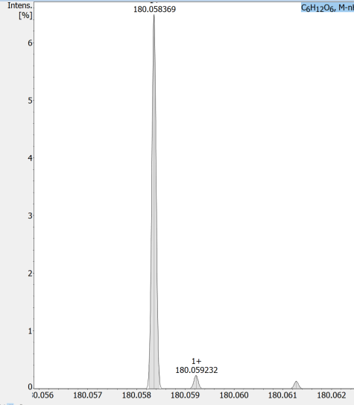
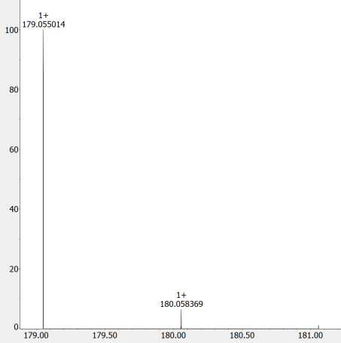
Formula Assignment and Isotopologues
Confidence Scores (CoreMS)
Combines m/z error and isotopic pattern
Note, we observe not just the monoisotopic species, but isotopologues too, e.g.
Monoisotopic: ¹²C₆ ¹H₁₂ ¹⁶O₆
A+1 Isotopologue:
¹³C₁ ¹²C₅ ¹H₁₂ ¹⁶O₆
¹²C₆ ²H₁ ¹H₁₁ ¹⁶O₆
¹²C₆ ¹H₁₂ ¹⁷O₁ ¹⁶O₅
¹³C₁¹²C₅¹H₁₂¹⁶O₆
180.058369
If we detect the predicted isotopologues, our confidence in the molecular formula is increased
[C₆H₁₂O₆-H]⁻
180.059232
¹²C₆ ¹H₁₂¹⁷O₁¹⁶O₅
180.061291
¹²C₆²H₁¹H₁₁¹⁶O₆

Slide 14
Data ‘Alignment’
Alignment on masses
Combining datasets – for comparative analysis – can be done two ways:
1) Alignment based on m/z prior to assignment (e.g. Formularity)
2) Alignment based on assigned formula (e.g. CoreMS)
Both approaches have their limitations
1) Alignment based on m/z assumes that similar (e.g. within 1 ppm) m/z values between samples are the same species
This is a big assumption.
Can artificially align features which shouldn’t be
2) Alignment based on Formula is more robust, but unassigned features can not be aligned and thus not compared
Unassigned features may still contain useful information
179.0811
179.0820
179.0815
Feature A
Formula
Alignment on formulas
179.0811
179.0820
179.0815
Formula
Formula
Formula
Feature A

Slide 15

Software for Data Processing
EMSL developed software framework for mass spectrometry data processing
Open Source
Python based
End-to-end workflows
Raw data support
Modular and extensible
GUI, CLI, and Code-level access
github.com/EMSL-Computing/CoreMS
Yuri E. Corilo, William R. Kew, Lee Ann McCue (2021, March 27). EMSL-Computing/CoreMS: CoreMS 1.0.0 (Version v1.0.0), as developed on Github. Zenodo. http://doi.org/10.5281/zenodo.4641553
Other software tools exist, including:
Bruker DataAnalysis (proprietary)
Formularity (EMSL, .exe)
Mass calibration and formula annotation
MFAssignR (MTU, R-based)
Noise thresholding, mass cal., formula annotation
UltraMassExplorer (AWI, web-based/R)
Formula annotation

Slide 16
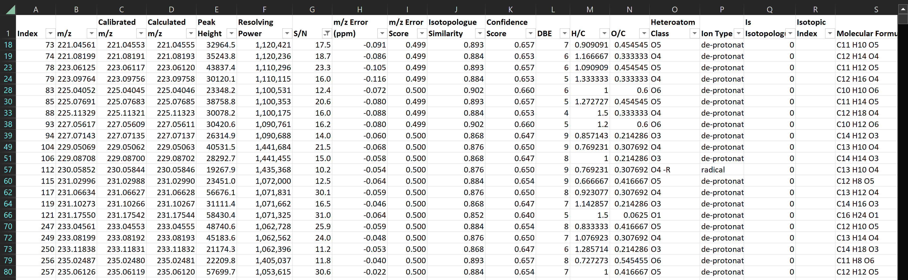
Output from the Data Processing Step
Long-form table of peaks detected in the spectrum
Includes measured properties
e.g. m/z, peak height, S/N
Includes assigned formula properties
e.g. formula, mass error, confidence score, DBE, O/C and H/C, class

Slide 17
Data Analysis and Interpretation
Typical spectrum metrics
Stoichiometric Properties
Aromaticity
Thermodynamics
Chemical Classification
Data Visualization
Statistical Analysis
Peak Intensity Usage
Software Tools and Training

Slide 18
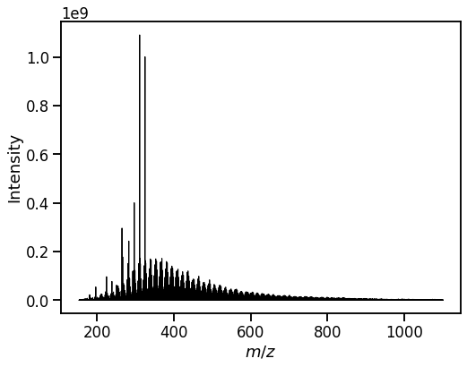
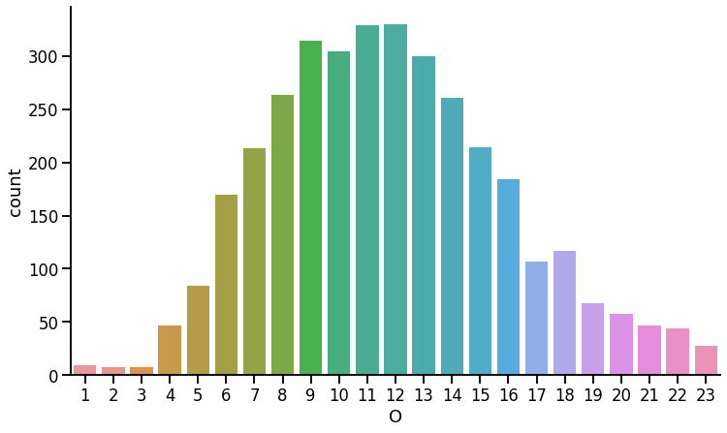
Spectrum Metrics
Spectrum of Suwanee River Fulvic Acid
Every spectrum has some basic metrics we often report or highlight
For Example:
Total number of peaks
9441
Total number of assignments
3507
r.m.s of m/z recalibration (ppm)
0.12
m.a.e of m/z of assignments (ppm)
0.11
Total Ion Current (TIC)
2x10⁸
Skewness of m/z distribution
0.266
Distribution of #O atoms in each assignment

Slide 19
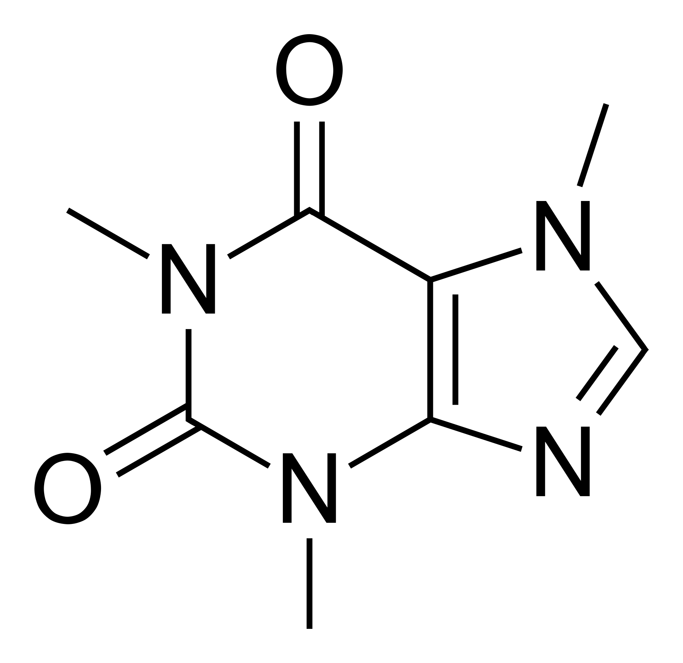
Stoichiometric Analysis
Elemental ratios allow us to predict some molecular properties
These allow us to infer biogeochemical traits
At simplest, the ratio of H/C can estimate saturation
Methane = CH₄. H/C = 4 = Saturated
Benzene = C₆H₆. H/C = 1 = Unsaturated
Other elemental ratios can be calculated
Combinations of elemental ratios can yield more sophisticated inferences
m/z 195.08765
m/z
[C₈H₁₀N₄O₂ + H]⁺
Stoichiometric Analysis
H/C = 1.25
O/C = 0.25
DBE = 8
AI_{mod} = 0
NOSC = 0.75
Caffeine

Slide 20
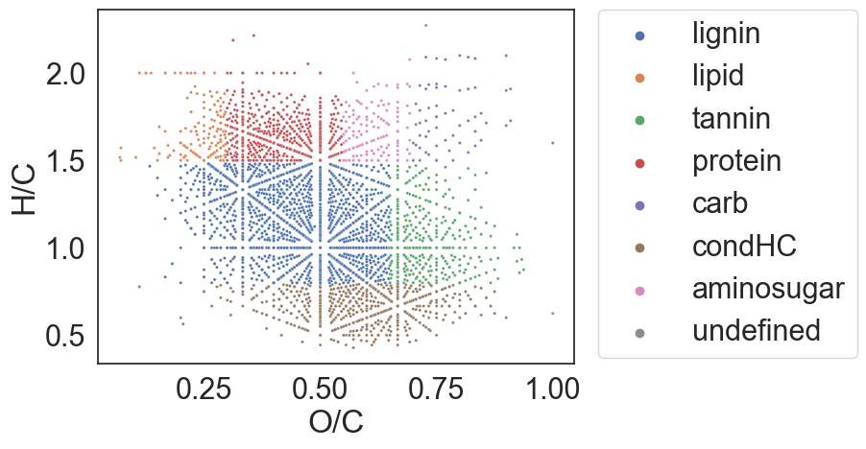
Data Visualization – Van Krevelen Diagrams
Example van Krevelen diagram of a soil extract
Van Krevelen diagrams are one of the most common ways to present complex mixture FTICR MS data
Named after Dirk van Krevelen’s work in the 1950s
van Krevelen, D.W. (1950). "Graphical-statistical method for the study of structure and reaction processes of coal", Fuel, 29, 269–84
Modern usage plots every assigned formula on a 2D scatter plot with O/C (x-axis) vs H/C ratio
Less commonly, N/C instead of O/C
Regions of the plot can be used to infer chemical class
n.b. – many class definitions are overly simplistic
Many of the most used definitions do not require ‘aminosugar’ or ‘protein’ species to contain N!
Regardless of definition set used – recall these are ‘class-like’ compounds
e.g. ‘lipid-like’ or ‘lignin-like’

Slide 21
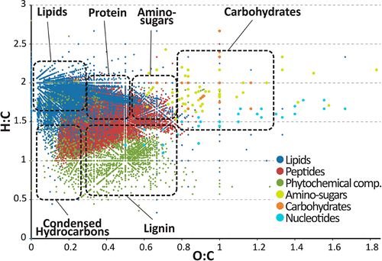
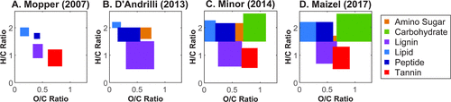
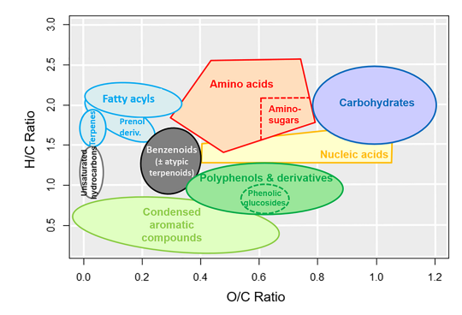
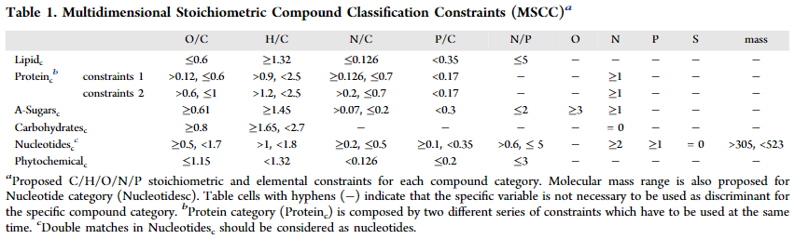
Chemical Classification from Van Krevelen Space
J. Am. Soc. Mass Spectrom. 2022, 33, 1, 198-202
Phytochemical Analysis. 2022;33:1111–1120
Anal. Chem. 2018, 90, 10, 6152-6160

Slide 22
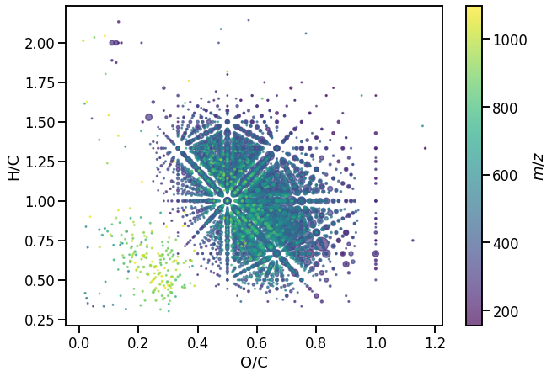
Van Krevelen Diagrams - Continued
Renaissance of van Krevelen diagrams started in the early-2000s
Anal. Chem. 2003, 75, 5336
Anal. Chem. 2004, 76, 2511
Extended ways to visualize the data have been presented
Color coding the glyphs
Size coding the glyphs
3D plots
(avoid in publication!)
Interactive plots
Example van Krevelen diagram for Suwanee River Fulvic Acid standard
Journal of the American Society for Mass Spectrometry. 2017, 28 (1): 200–213
Rapid Commun Mass Spectrom. 2017, 31 (7): 658–662.

Slide 23
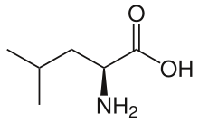
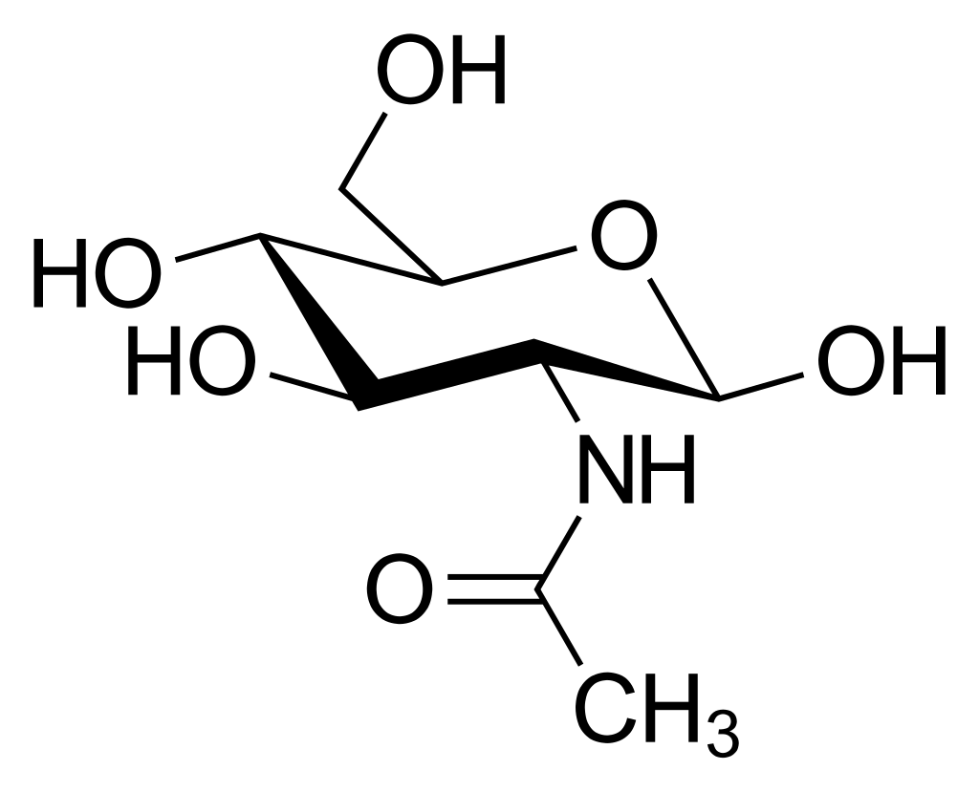
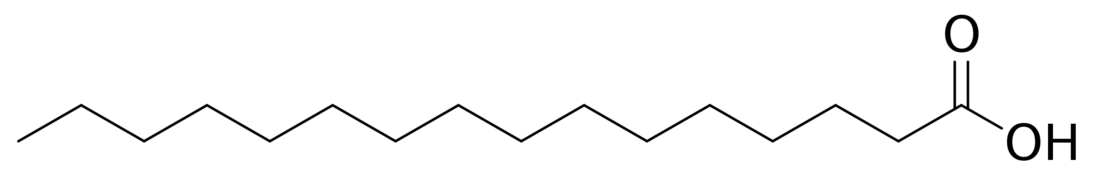
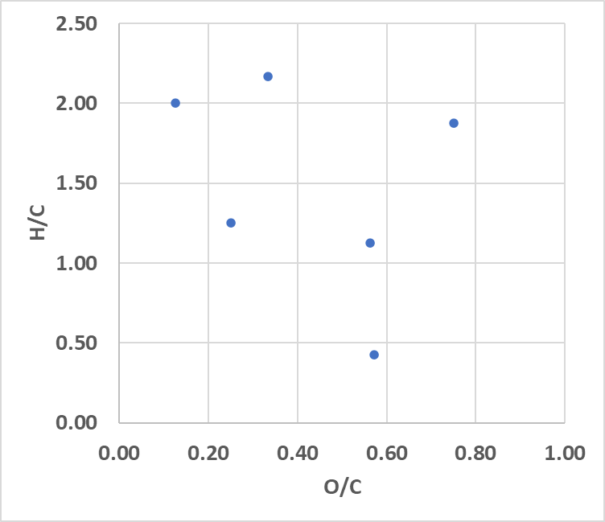
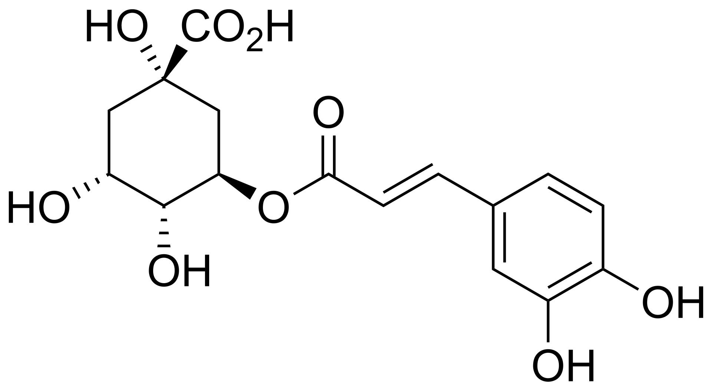
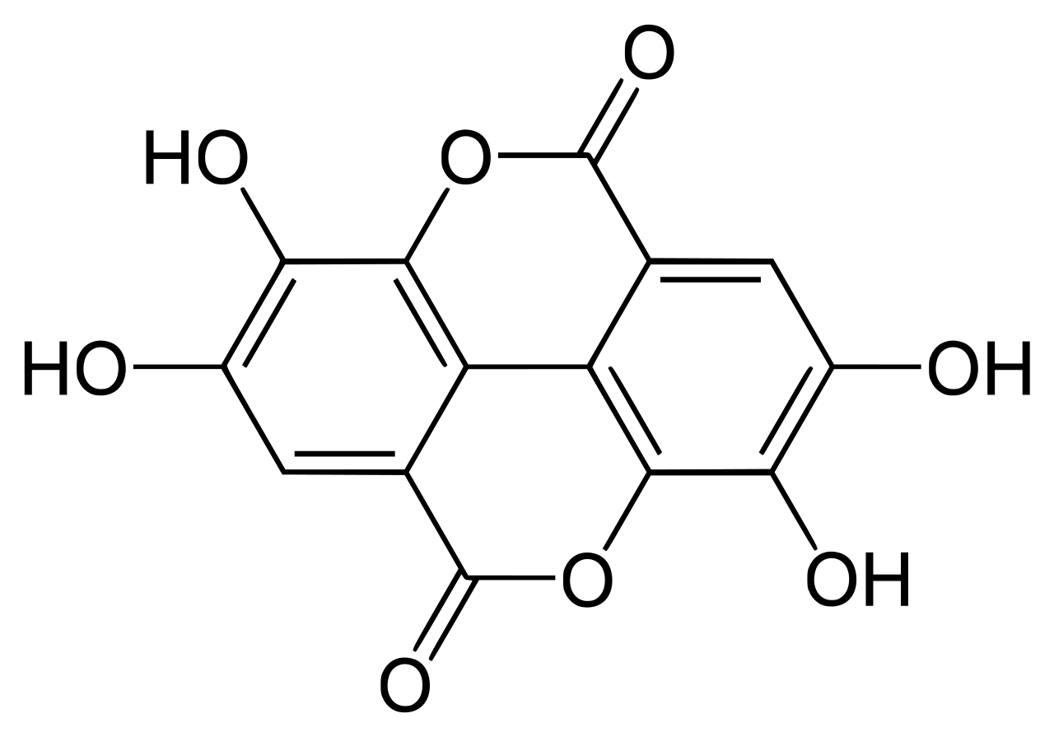
Van Krevelen Diagram – Example Molecules
Leucine
N-Acetylglucosamine
C₆H₁₃NO₂
C₈H₁₅NO₆
Palmitic Acid
C₁₆H₃₂O₂
Chlorogenic Acid
C₁₆H₁₈O₉
Caffeine
C₈H₁₀N₄O₂
Ellagic Acid
C₁₄H₆O₈

Slide 24
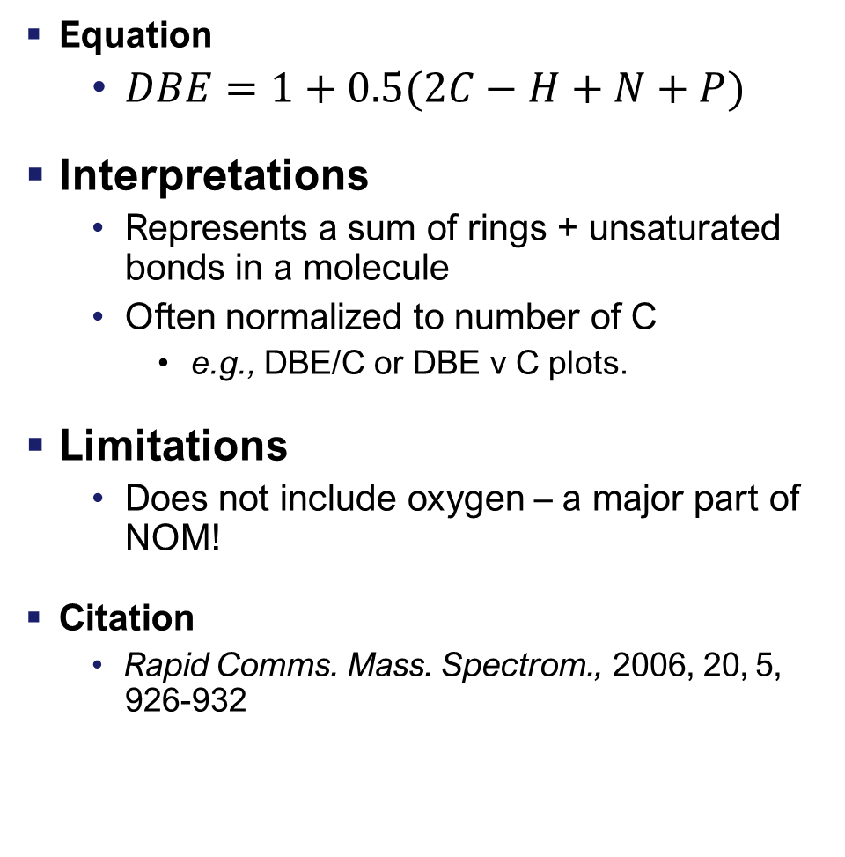
DBE – Double Bond Equivalents
Chlorogenic Acid
C₁₆H₁₈O₉,
mw = 354 Da
Equation
$DBE=1+0.5(2C−H+N+P)$
Interpretations
Represents a sum of rings + unsaturated bonds in a molecule
Often normalized to number of C
e.g., DBE/C or DBE v C plots.
Limitations
Does not include oxygen – a major part of NOM!
Citation
Rapid Comms. Mass. Spectrom., 2006, 20, 5, 926-932
DBE = 8
DBE/C = 0.5
Ellagic Acid
C₁₄H₆O₈,
mw = 302 Da
DBE = 12
DBE/C = 0.86
N-Acetylglucosamine
C₈H₁₅NO₆,
mw = 221 Da
DBE = 2
DBE/C = 0.25

Slide 25
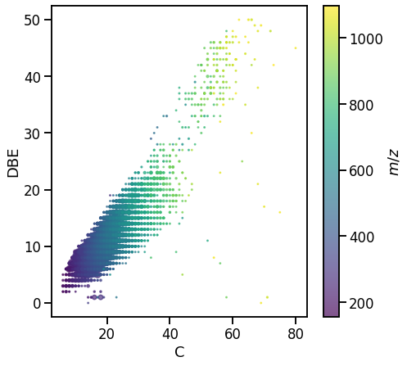
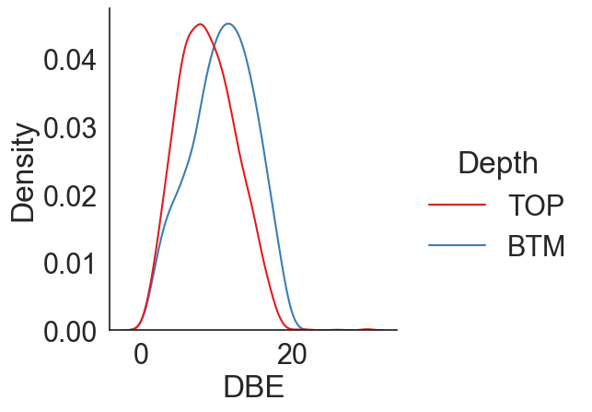
Data Visualization – DBE
DBE vs C for a single sample – each assigned formula is a point
Distribution of DBE values between two samples of two different depths
Deeper samples (bottom) have higher DBE – more unsaturation

Slide 26
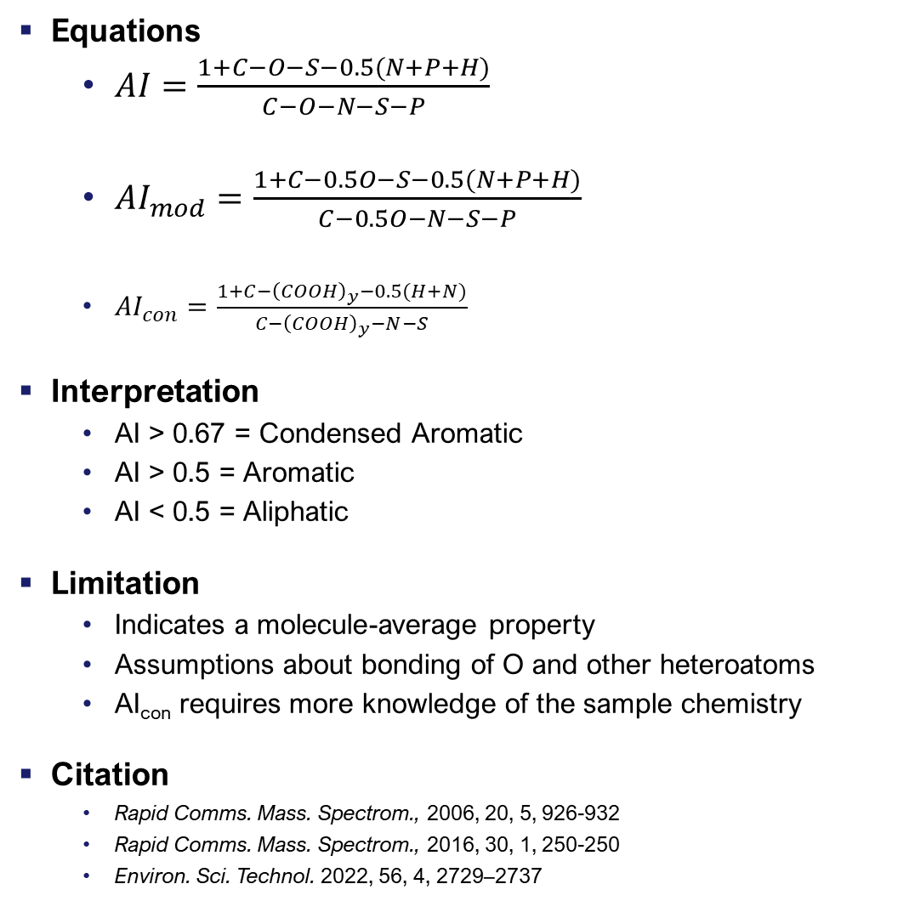
AI – Aromaticity Index
Chlorogenic Acid
Equations
$AI=\frac{1+C−O−S−0.5(N+P+H)}{C−O−N−S−P}$
$AI_{mod}=\frac{1+C−0.5O−S−0.5(N+P+H)}{C−0.5O−N−S−P}$
$AI_{con}=\frac{1+C−{\left(COOH\right)}_{y}−0.5(H+N)}{C−{\left(COOH\right)}_{y}−N−S}$
Interpretation
AI > 0.67 = Condensed Aromatic
AI > 0.5 = Aromatic
AI < 0.5 = Aliphatic
Limitation
Indicates a molecule-average property
Assumptions about bonding of O and other heteroatoms
AI_{con} requires more knowledge of the sample chemistry
Citation
Rapid Comms. Mass. Spectrom., 2006, 20, 5, 926-932
Rapid Comms. Mass. Spectrom., 2016, 30, 1, 250-250
Environ. Sci. Technol. 2022, 56, 4, 2729–2737
n.b. typo in the original publication, first two equations are based on the corrected article
C₁₆H₁₈O₉,
mw = 354 Da
AI = 0.0 (aliphatic)
AI_{mod} = 0.3 (aliphatic)
AI is constrained between 0 and 1
Ellagic Acid
C₁₄H₆O₈,
mw = 302 Da
AI = 0.67 (aromatic)
AI_{mod} = 0.80 (cond. aromatic)
N-Acetylglucosamine
C₈H₁₅NO₆,
mw = 221 Da
AI = 0 (aliphatic)
AI_{mod} = 0 (aliphatic)

Slide 27
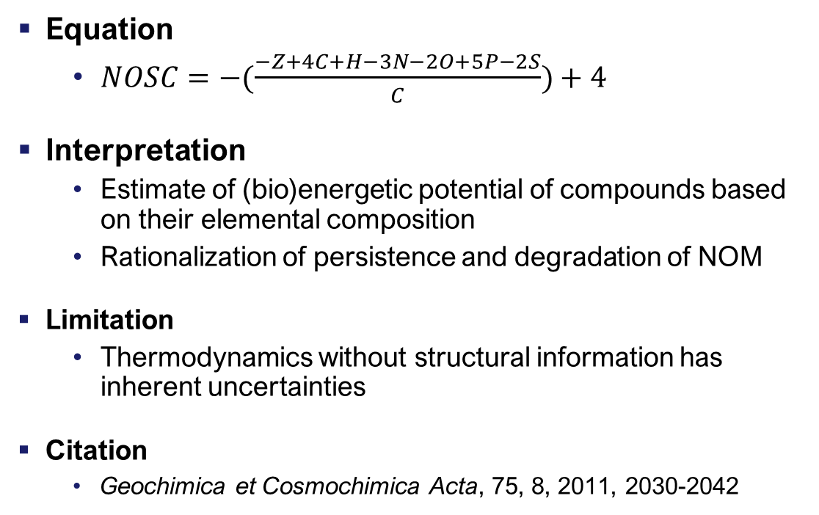
NOSC – Nominal Oxidation State of Carbon
Chlorogenic Acid
C₁₆H₁₈O₉,
mw = 354 Da
Equation
$NOSC=−(\frac{−Z+4C+H−3N−2O+5P−2S}{C})+4$
Interpretation
Estimate of (bio)energetic potential of compounds based on their elemental composition
Rationalization of persistence and degradation of NOM
Limitation
Thermodynamics without structural information has inherent uncertainties
Citation
Geochimica et Cosmochimica Acta, 75, 8, 2011, 2030-2042
NOSC = 0
Ellagic Acid
C₁₄H₆O₈,
mw = 302 Da
NOSC = 0.71
N-Acetylglucosamine
Leucine
Palmitic Acid
C₈H₁₅NO₆,
mw = 221 Da
NOSC = 0
NOSC = -1.0
C₆H₁₃NO₂,
mw = 131 Da
C₁₆H₃₂O₂,
mw = 256 Da
NOSC = -1.75

Slide 28
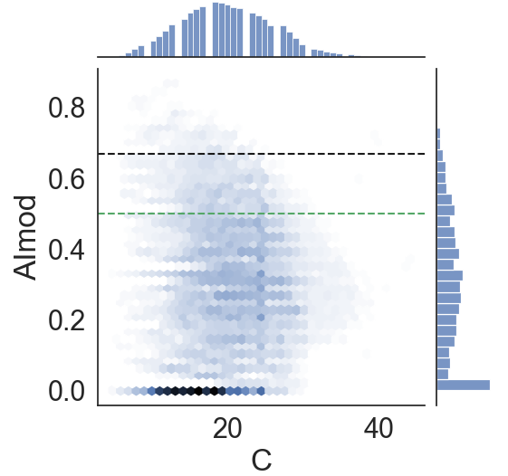
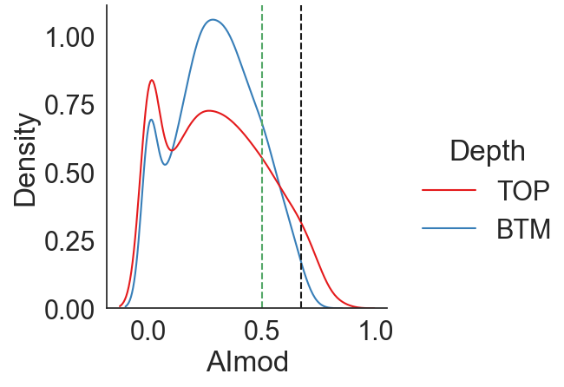
Data Visualization – AI_{mod}
Distribution of AI_{mod} values between two samples of two different depths
AI_{mod} vs C for a single sample
Aliphatic
Aromatic
Condensed aromatic
Condensed aromatic
Aromatic
Aliphatic
This is a ‘hex-binned’ density plot, showing the values of each assigned formula, but aggregated by count
Top and Right projections show 1D histograms
This shows a different story to DBE!
Here the shallower depth (top) contains a broader distribution of AImod values, including more condensed aromatic species

Slide 29


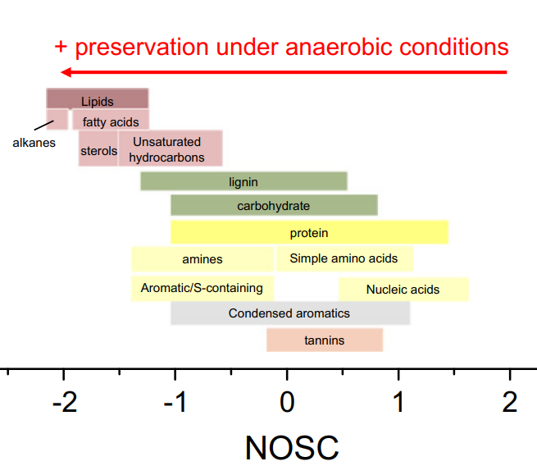
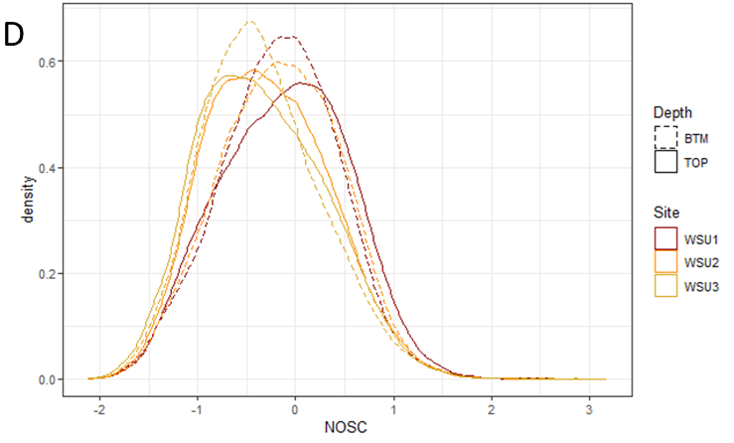
NOSC
= NOSC
Estimated NOSC values for various SOM components
Biogeochemistry (2016) 127:157–171
Front. Soil Sci., 14 April 2023 Sec. Soil Biogeochemistry & Nutrient Cycling Volume 3 - 2023 | https://doi.org/10.3389/fsoil.2023.1120425
Notes:
Biogeochemistry (2016) 127:157–171

Slide 30

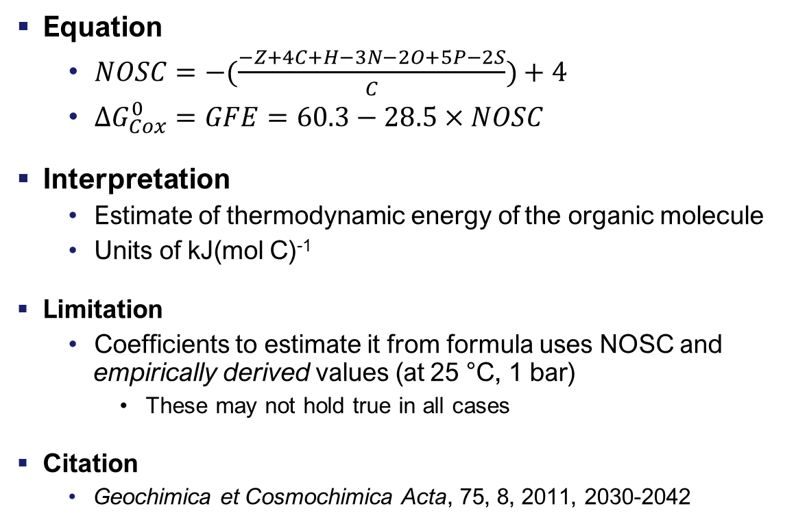
Cox Gibbs Free Energy ($ΔG_{Cox}^{0}$, GFE)
Chlorogenic Acid
Equation
$NOSC=−(\frac{−Z+4C+H−3N−2O+5P−2S}{C})+4$
$ΔG_{Cox}^{0}=GFE=60.3−28.5×NOSC$
Interpretation
Estimate of thermodynamic energy of the organic molecule
Units of kJ(mol C)⁻¹
Limitation
Coefficients to estimate it from formula uses NOSC and empirically derived values (at 25 °C, 1 bar)
These may not hold true in all cases
Citation
Geochimica et Cosmochimica Acta, 75, 8, 2011, 2030-2042
C₁₆H₁₈O₉,
mw = 354 Da
GFE = 60.3
Ellagic Acid
C₁₄H₆O₈,
mw = 302 Da
GFE = 39.9
N-Acetylglucosamine
Leucine
Palmitic Acid
C₈H₁₅NO₆,
mw = 221 Da
GFE = 60.3
GFE = 110.2
C₆H₁₃NO₂,
mw = 131 Da
C₁₆H₃₂O₂,
mw = 256 Da
GFE = 88.8

Slide 31
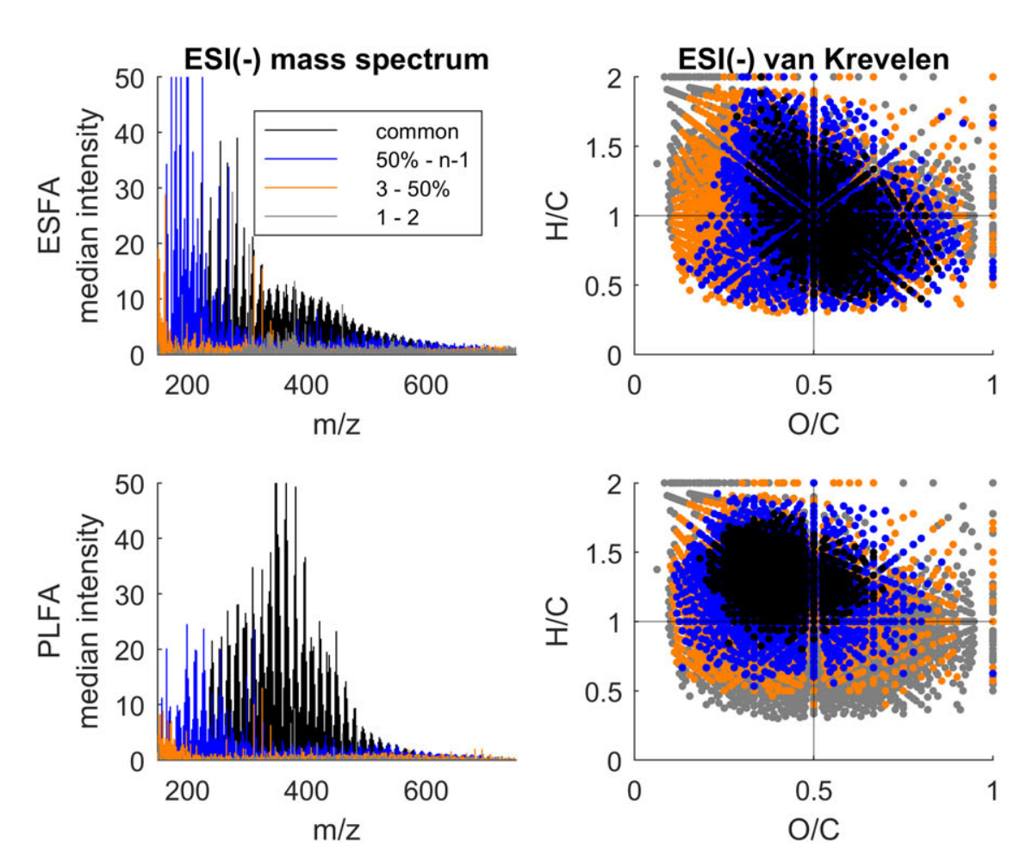
Comparing Datasets – Between Time and Instrument
Reproducibility and repeatability of direct infusion FTMS is a perennial question
Correcting for batch effects is not a solved problem
Interlaboratory studies do provide some guidance on comparisons
Same standards run in ~20 labs
Some ions common to most, some aren’t.
Limnol Oceanogr Methods, 18: 235-258. https://doi.org/10.1002/lom3.10364

Slide 32
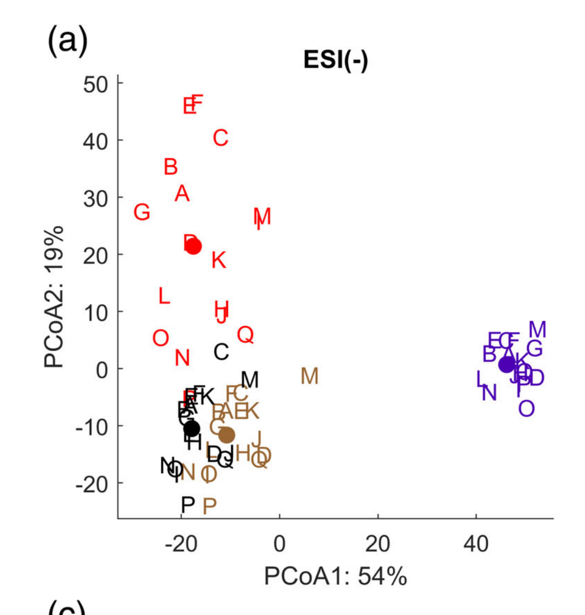
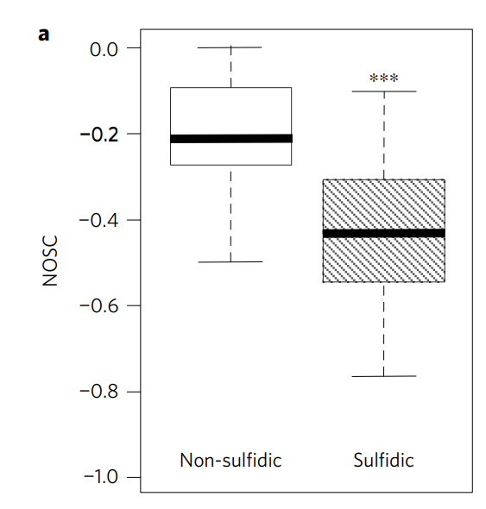
Statistical Analysis
Limnol Oceanogr Methods, 18: 235-258.
Principal coordinate analysis
Statistical comparison can take many forms
Unsupervised methods
e.g. PCA, PCoA
using formula-level info (intensity, presence-absence)
Traditional methods on aggregated properties
e.g. t-tests or ANOVA on NOSC values
Appropriate statistical analysis requires careful consideration of:
Experiment design
Normalisation
Validation
Nature Geosci 10, 415–419 (2017).
Welch’s unbalanced t-test

Slide 33
Peak Intensities
Sources of Non-Quantitative Peak Intensities
Extraction Biases
SPE Biases
Matrix Effects
Ionization Efficiency
Ionization Suppression
Instrumental Biases
Mass spectrometry peaks are not of arbitrary intensity
However, the features are not directly quantitative of the amount of that material in the original sample
Use of peak intensities must be done very cautiously!

Slide 34
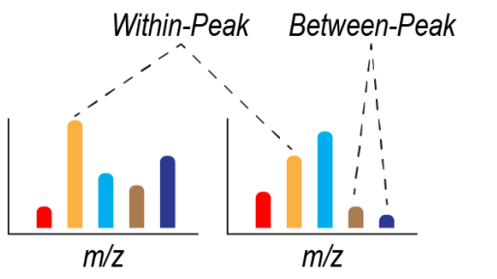
Peak Intensities
Comparing different peak intensities within the same spectrum = never quantitative
Comparing the same peak between spectra = can have quantitative value, but often must be used very cautiously
Reviews and syntheses: Use and misuse of peak intensities from high resolution mass spectrometry in organic matter studies: opportunities for robust usage
https://egusphere.copernicus.org/preprints/2022/egusphere-2022-1105/
doi:10.5194/egusphere-2022-1105

Slide 35
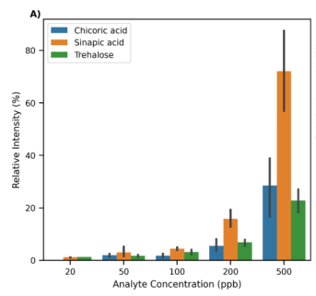
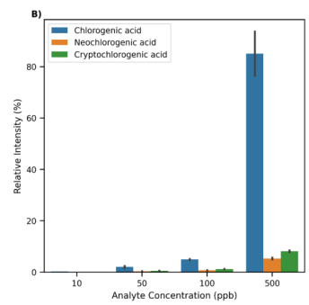
Peak Intensities – Pure Compounds, Idealised Case
If we only know molecular formula, we don’t know – for sure – the same formula is the same molecule in different samples – so even comparing the same peak can be difficult in otherwise ideal situations
Direct infusion of three different chemicals, individually, at the same concentration shows massive differences in relative signal intensity
Even here using three isomeric compounds, they yield massive differences in relative signal intensity
Reviews and syntheses: Use and misuse of peak intensities from high resolution mass spectrometry in organic matter studies: opportunities for robust usage
https://egusphere.copernicus.org/preprints/2022/egusphere-2022-1105/
doi:10.5194/egusphere-2022-1105

Slide 36
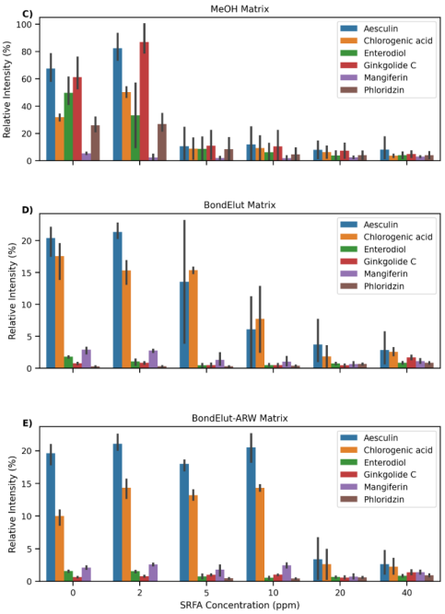
Peak Intensities – Mixture, Complex Matrix
Known compounds at fixed concentration
Spiked into different matrices
Methanol, SPE-eluted methanol, Salted SPE eluted methanol
With varied concentrations of SRFA added
Each compound behaves differently
Different matrices yield different responses
Direct use of peak intensity data in real samples, with complex and variable matrices, is not encouraged
However…
Reviews and syntheses: Use and misuse of peak intensities from high resolution mass spectrometry in organic matter studies: opportunities for robust usage
https://egusphere.copernicus.org/preprints/2022/egusphere-2022-1105/
doi:10.5194/egusphere-2022-1105

Slide 37

Peak Intensities – Aggregated Properties
Direct use of peak intensity data in real samples, with complex and variable matrices, is not encouraged
However, there seems to be some cases where aggregating spectrum properties with some intensity ‘weighting’ can yield valid interpretation.
Possibly, due to the law of large numbers – where comparing one peak intensity isnt valid, across hundreds or thousands, properties ‘average out’
Here – we simulated a dataset of 100 or 1000 peaks, and added random error to the peak intensities.
We then calculated various metrics (e.g. α- or β-diversity)
With larger datasets, the calculated metrics reflect the true values
Much more work is required in this area to develop robust guidance
Reviews and syntheses: Use and misuse of peak intensities from high resolution mass spectrometry in organic matter studies: opportunities for robust usage
https://egusphere.copernicus.org/preprints/2022/egusphere-2022-1105/
doi:10.5194/egusphere-2022-1105

Slide 38



Software for Data Analysis
Each tool has various strengths depending on data analysis Qs
ftmsRanalysis
R based toolkit for downstream analysis
github.com/EMSL-Computing/ftmsRanalysis
PLoS Comput Biol 16(3): e1007654
FREDA
Shiny web app for downstream analysis
https://shinyproxy.emsl.pnnl.gov/app/freda
github.com/EMSL-Computing/FREDA
PyKrev
Python library for downstream analysis
J. Am. Soc. Mass Spectrom. 2021, 32, 5, 1263–1267
github.com/Kzra/pykrev
MetaboDirect
R & Python based library
github.com/Coayala/MetaboDirect
Microbiome 11, 28 (2023)

Slide 39

Software for Data Analysis – Shiny App
https://shinyproxy.emsl.pnnl.gov/app/1000soils

Slide 40

Introduction to Session 4
In our ‘Hands-On’ session, we will practice exploring real SOM FTICR datasets
Calculating metrics
Visualizing data
Comparing samples
We will use basic Jupyter Notebooks
Explore the code yourself:
github.com/EMSL-MONet/CommSciMtg_Nov23/

Slide 41
Questions?
william.kew@pnnl.gov

Slide 42
Thank you

